Slide 1
THE WHO
Team Members:
Vitaly Theriault
Namitha Logishetty
Lokesh Yadav Ramanaboina
Sachin Krishna Nelakonda
Target Market: Generations X,Y,Z.
Value Proposition:
1. It is most useful for ‘hearing impaired’ people.
2. Transcripted data will be a key for organisations.
3. Small fee to transcribe discord meetings for multiple users.

Slide 2
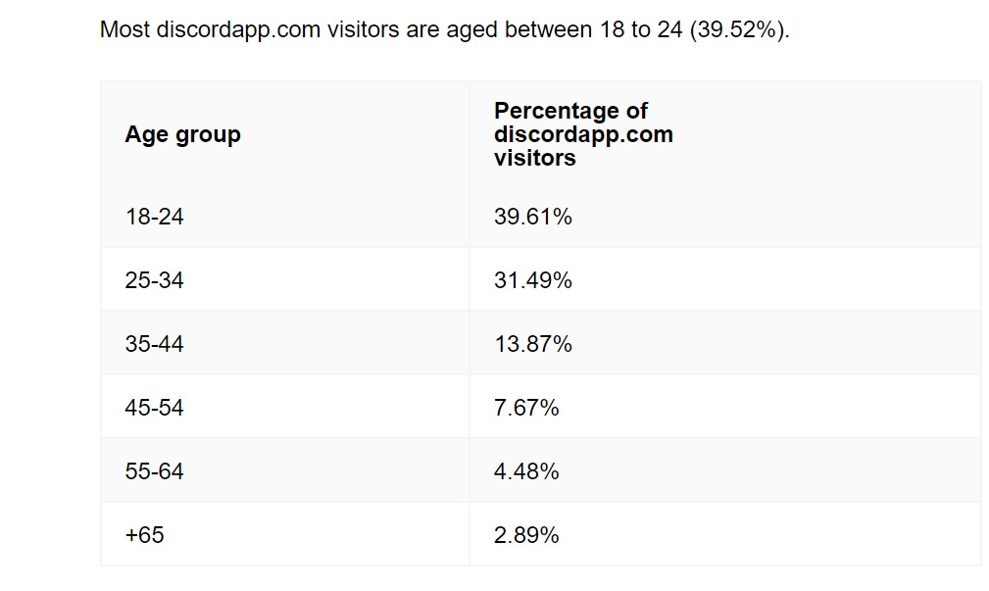
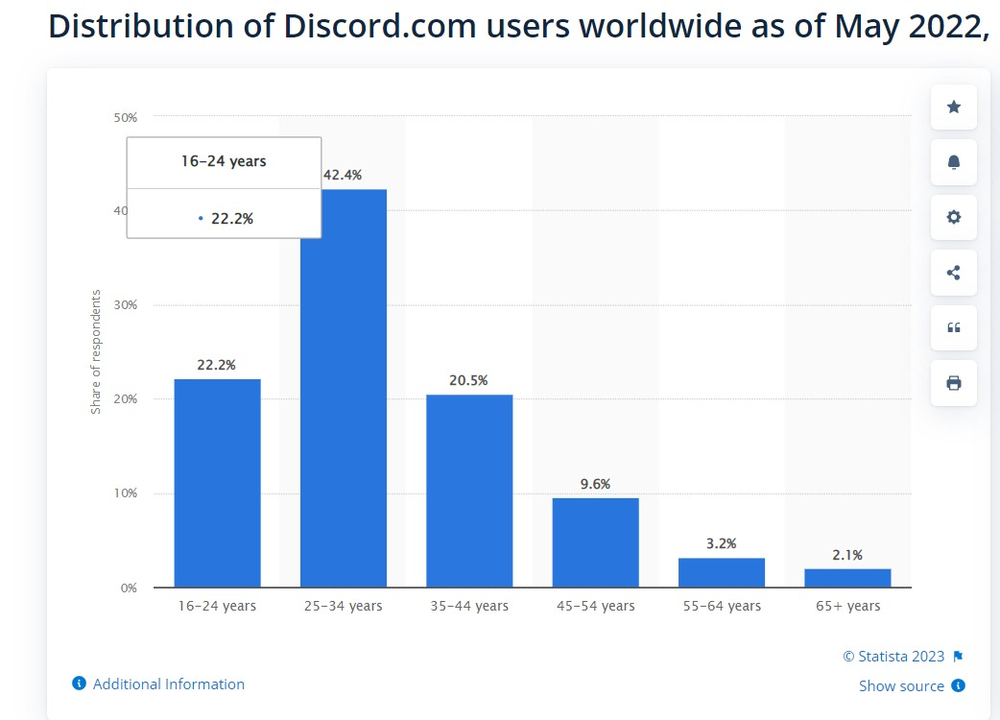
Discord Users Charts :
Source (1st image ): https://onehourprofessor.com/how-to-make-money-on-discord/
(2nd image) : https://www.statista.com/statistics/1327674/discord-user-age-worldwide/

Slide 3
The Pain we solved
After a discord meeting it can be easy to forget everything that was said. Or someone missed the meeting.
No one ever volunteers to be the notetaker
The Medicine – Created the text transcript of the meeting

Slide 4
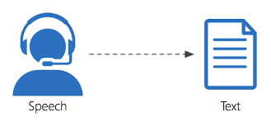
How did we Fixed it?
Get each user audio from Discord
Use Google AI Speech-to-Text API
https://cloud.google.com/speech-to-text
When you use the API, your audio data is uploaded to Google Cloud and processed by the speech recognition models that are distributed across multiple servers. This allows the API to handle large volumes of data and provide quick results. The underlying infrastructure of Google Cloud uses distributed computing concepts to efficiently distribute and process data across multiple servers, ensuring high availability and scalability.

Slide 5
Key Winning Features and Capabilities
Transcription Per User: This Application will generate transcripts for each user. This can be particularly useful in group meetings for multiple users.
Speaker Identification: This Application identifies the user transcripts based on the user id and the Timestamps during the meeting.
Multilingual support: Google Speech-to-Text API supports a wide range of languages, including English, German, and many others. This can be especially helpful for global teams and multi-lingual meetings.

Slide 6

Key Winning Features and Capabilities
The bot can recognize the speech input from users through the microphone and convert it to text format.
This Application is easy to Integrate to Any Discord Server as the bot will listen to the voice events and perform speech to text services easily.

Slide 7
Justifications
The current Market Needs an cost effective Application which will transcribe the meetings in Discord with easy setup.
Accessibility: By using Speech to text Services in Discord, users with hearing impairments will able to participate in the meeting and can communicate effectively
Reduce Manual Effort: This Application reduces human manual note taking process as they can go through the transcription generated rather than listening the Entire Audio.

Slide 8
Justifications
Google Speech-to-Text API is known for its high accuracy with 95% in speech-to-text transcription, which can help ensure that meeting content is accurately transcribed, that means the Word Error Rate (WER) of the Google API is 5%.
Inclusivity: Speech-to-text transcription can help ensure that all meeting participants are included in the conversation, regardless of their language, accent.

Slide 9
Plan we implemented
Create discord server
Create discord bot & add it to discord server
Extract each user audio from discord meeting using discord API
Pass each user audio to Google speech to text API
Test and deploy
Pass transcript to separate channel In discord
Get each user transcripts from Google API

Slide 10
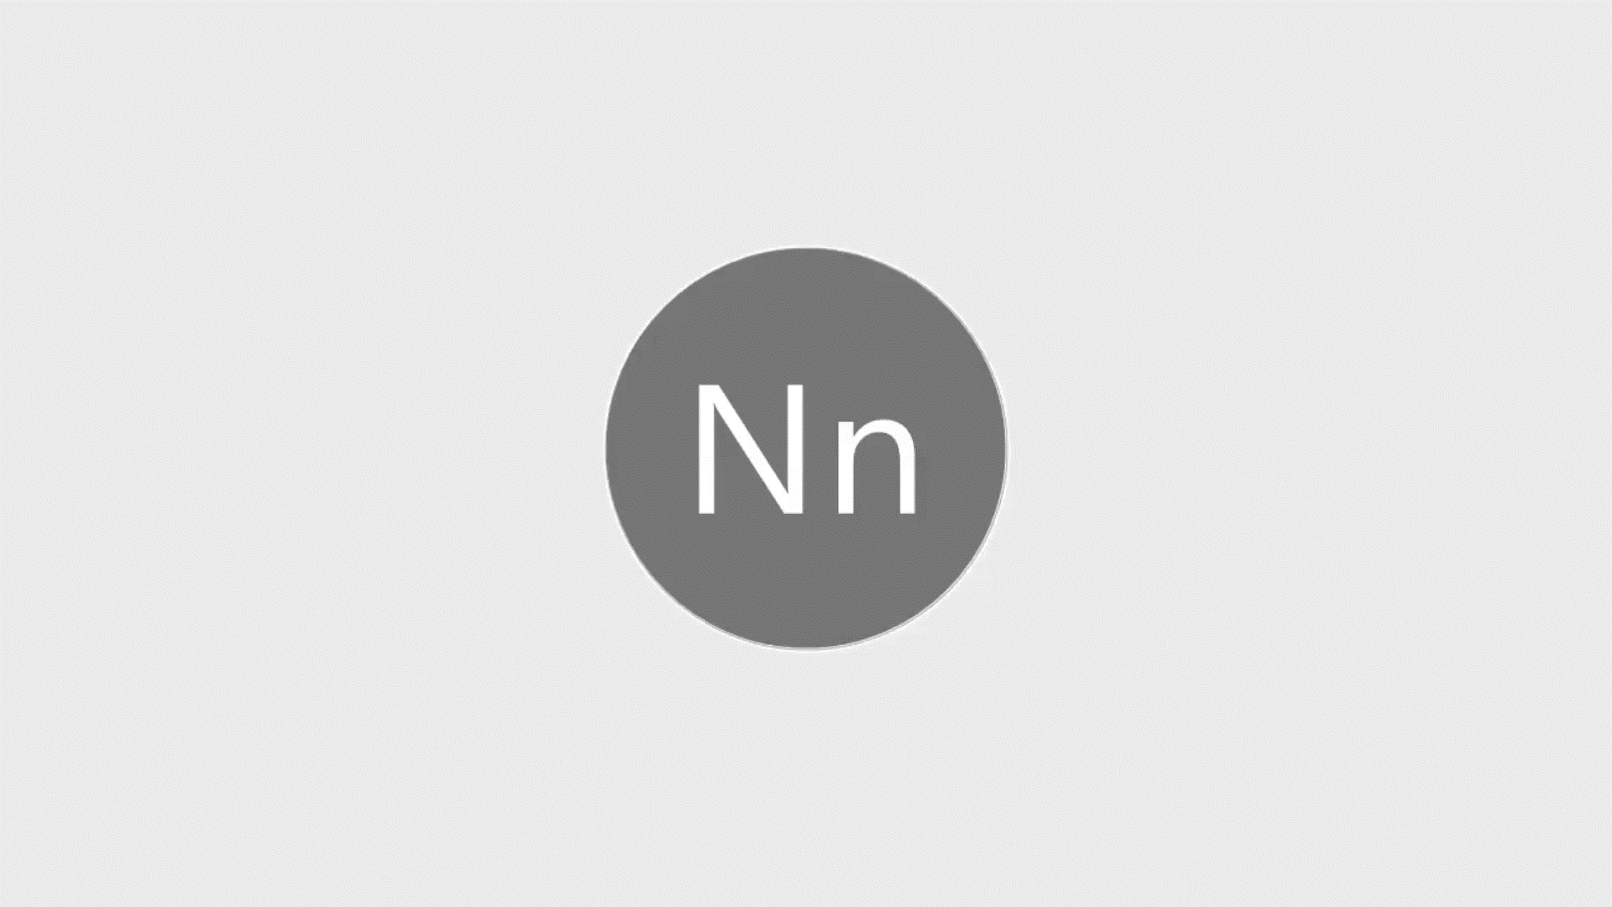
Recorded video

Slide 11
Current status of the project
Transcription is working for the single and multiple users.
We succeeded to transcribe audio per user and getting the text file.
The accuracy is 90% with word error rate of 16% .
Time stamps are recorded and succeeded in speaker recognition.
Multilanguage feature is working but we are able to transcribe in two languages.
Deployed the project on Heroku platform
https://discord.com/api/oauth2/authorize?client_id=1095116635397959741&permissions=3148288&scope=bot
The above link is the public bot we developed and if you have your own discord server you can use this link and add the bot to your server.

Slide 12
How can we make profit?
Charging users: You could charge users a fee for accessing the speech-to-text functionality. This could be a one-time fee or a subscription-based model.
Data monetization: Another option is to monetize the data collected from the users. You could use the transcribed text data to train machine learning models or sell it to third-party companies for research or marketing purposes.
Enterprise solutions: You could also offer the speech-to-text functionality as a service to businesses or enterprises. For example, you could provide an API that businesses can integrate into their own applications

Slide 13
Team Members and contributions
Vitaly Theriault – responsible for audio extraction from discord meeting.
Lokesh Yadav Ramanaboina – responsible for transcript generation from audio files extracted
Namitha Logishetty- responsible for transcript generation and multilanguage support and testing.
Sachin krishna Nelakonda – responsible for deployment.

Slide 14
Thank You
Questions

